Slide 1
FrontlineSMS
FrontlineSMS is a desktop software created to lower barriers to positive social change using mobile technology.
FrontlineSMS enables instantaneous two-way communication to any mobile handset. It’s easy to implement, simple to operate, and best of all, the software is free; you only pay for the messages you send.
Using FrontlineSMS with FrontlineSync, you can also track missed calls for the first time.

Slide 2
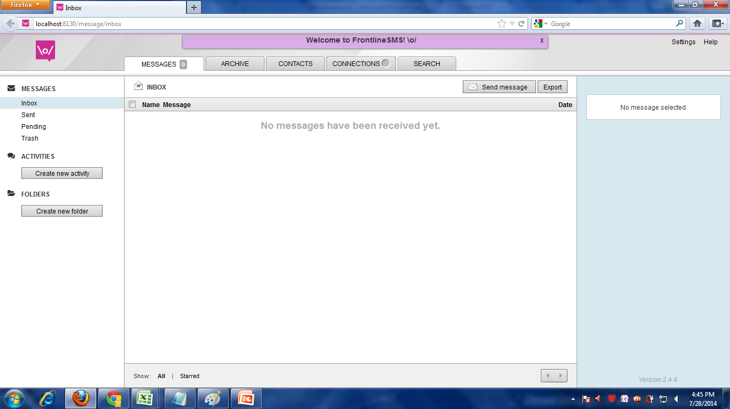

Slide 3
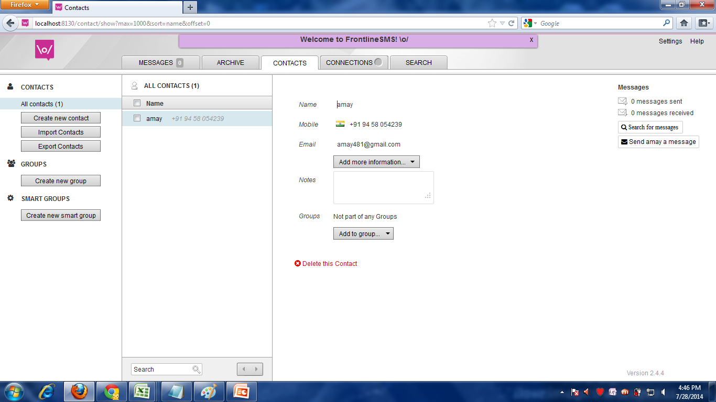

Slide 4
FrontlineSync
FrontlineSync is an Android app (running on v. 2.3 and up) which lets you easily send and receive messages to and from FrontlineSMS.
FrontlineSync also registers missed calls to the phone in your FrontlineSync workspace.

Slide 5
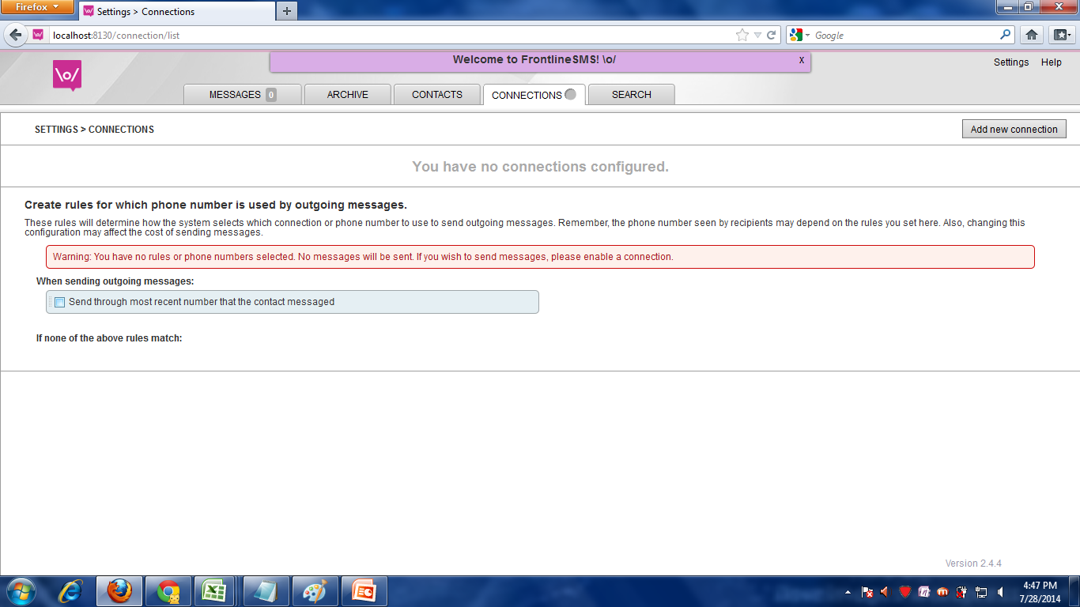

Slide 6
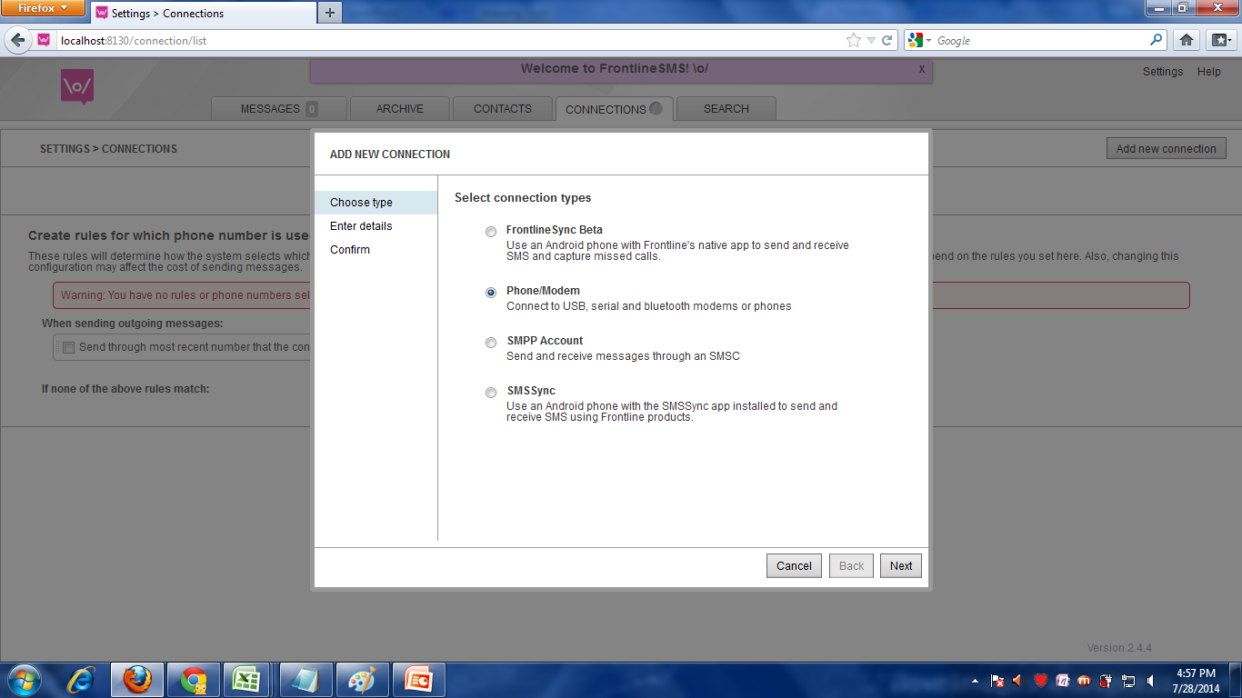

Slide 7
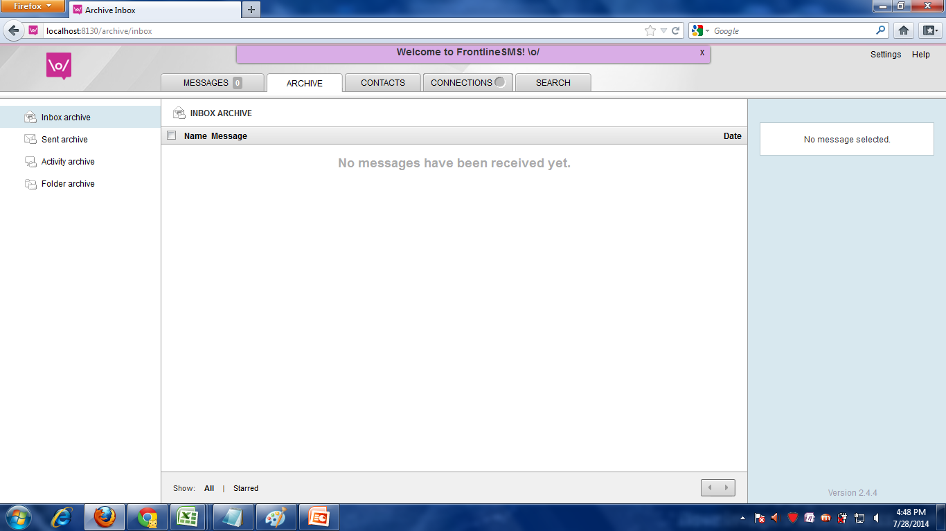

Slide 8
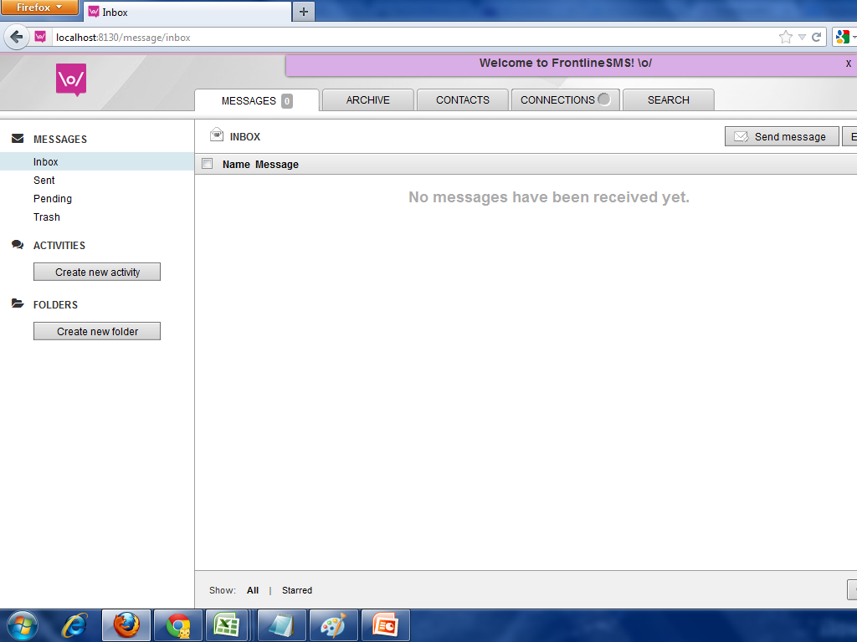

Slide 9
